Slide 1
Chi-Square Test of Independence

Slide 2
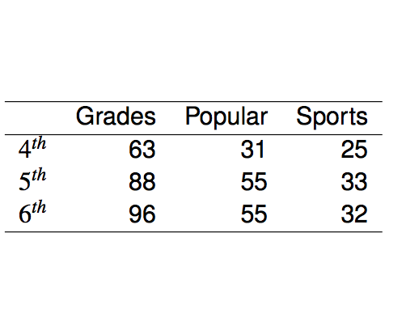
Popular kids
In the dataset popular, students in grades 4-6 were asked whether good grades, athletic ability, or popularity was most important to them. A two-way table separating the students by grade and by choice of most important factor is shown below. Do these data provide evidence to suggest that goals vary by grade?

Slide 3
Chi-square test of independence
The hypotheses are:
H₀: Grade and goals are independent. （Goals do not vary by grade.）
H_{A}: Grade and goals are dependent. （Goals vary by grade.）

Slide 4
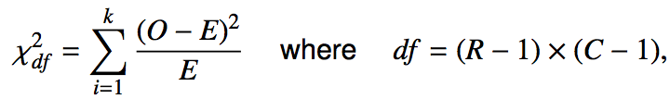

Chi-square test of independence
The test statistic is calculated as
_______________
Note:

Slide 5
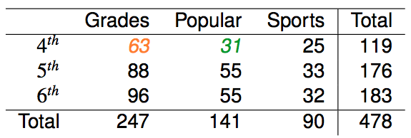


Expected counts in two-way tables

Slide 6
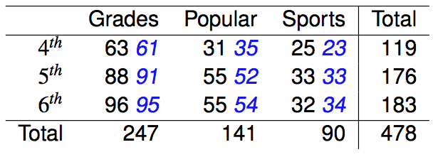

Calculating the test statistic in two-way tables
Expected counts are shown in blue next to the observed counts.

Slide 7
Calculating the test statistic in two-way tables
Expected counts are shown in blue next to the observed counts.

Slide 8
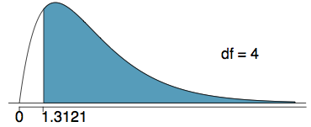

Calculating the p-value
Which of the following is the correct p-value for this hypothesis test?
χ²_{df} = 1.3121 df = 4
Note: The p-value is the area under the χ²_{df} curve, above the calculated test statistic.
P-value =0.8593

Slide 9
Conclusion
Do these data provide evidence to suggest that goals vary by grade?
H₀: Grade and goals are independent. Goals do not vary by grade.
H_{A}: Grade and goals are dependent. Goals vary by grade.
Since the p-value is larger than α (0.05), we fail to reject H₀.The data do not provide convincing evidence that grade and goals are dependent. It doesn't appear that goals vary by grade.

Slide 10
Limitations of the Chi-Square Test
The chi-square test is sensitive to sample size.
Usually, no more than 20% of the expected counts are less than 5 and all individual expected counts are 1 or greater. In particular, all four expected counts in a 2 x 2 table should be 5 or greater.

Slide 11
Fisher’s Exact Test
When the sample size is small, perform the Fisher’s exact test for the independence of two categorical variables.

